Slide 1



17 Mar
21 Mar
2025

Slide 2
Designing for people who have experienced domestic abuse

Slide 3
Content warning: Domestic abuse. Please keep yourselves safe.

Slide 4
Hello!
Angela (content designer), Peter (user researcher) and Sonya (delivery manager); also Roberta (user researcher)
Work on ‘Check if you can get legal aid’ in the Legal Aid Agency
One of the main ways people get access to legal aid (government funding for legal work), and therefore access to justice

Slide 5
What we will take about today
Many people who use our service have experienced domestic abuse
The way our service is designed is creating barriers for this group
We’ll talk about some of the barriers and how we’re designing to improve things
We’re not experts, we don’t have all the answers
We want to share what we’ve found and join up pockets of work

Slide 6
Statistics
Source: Office for National Statistics, year to end of March 2024
1 in 5 adults have experienced domestic abuse since age 16
2.3 million estimated victims of domestic abuse in 2023-24
1.6 million women (70%) and 0.7 million men (30%)
Notes:
Overall prevalence and incidence
Office for National Statistics (ONS), released 27 November 2024, ONS website, statistical bulletin, Domestic abuse in England and Wales overview: November 2024
https://www.ons.gov.uk/peoplepopulationandcommunity/crimeandjustice/bulletins/domesticabuseinenglandandwalesoverview/november2024

Slide 7
Barrier: I’m not sure if my experience counts as domestic abuse

Slide 8
Why this is a barrier in our service
We ask users to find their problem in a list
If they cannot identify their problem, they cannot go on to the next stage of applying for legal aid
How might we use the right language to help people recognise their problem as domestic abuse?
“That looks like me”

Slide 9
Learning about the right language
Card sorts, tree testing and research
Starting with the most basic description and iterating Example: Language: Domestic abuse Scenario: “My ex-partner is stalking me.” Learning: People aren’t sure if it counts if it’s by an ex-partner. Iterate to: Domestic abuse - This could be by a partner or ex-partner.

Slide 10
Learning about the right language
Example
Language we tested: Domestic abuse - This could be by a partner or ex-partner.
Scenario we tested: “Since I left home, my father has been threatening to harm me.”
Learning: People aren’t sure if it counts if it’s by a family member.
Iterate to: Domestic abuse - This could be by a partner, ex-partner or family member.

Slide 11
Common myth: Only violence counts as domestic abuse

Slide 12
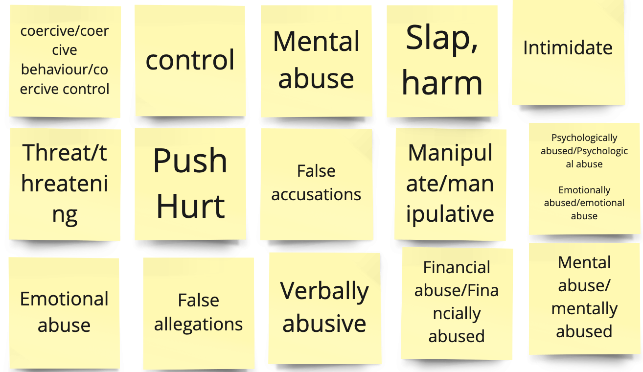
Learning about the right language
Analysing language from a freetext field in our service, ‘Tell us more about your problem’
People describing their experience in their own words

Slide 13
How we now describe domestic abuse
Domestic abuse
Includes controlling behaviour, emotional abuse, or if someone is harassing, threatening or hurting you or a child. This could be a partner, ex-partner, or family member.

Slide 14
Practical design work
Adopt, adapt, test and iterate this description
Consider content end-to-end, including on GOV.UK
Share your findings back with us and the cross-government design community

Slide 15
Barrier: It’s not safe for me to contact you

Slide 16
Why this is a barrier in our service
What we ask people to do:
Book an appointment with the call centre
Give your name, phone number and email address
Steps we already take to keep people safe:
Ask users “Can we say where we’re calling from?”

Slide 17
What we know
*Disclaimer: based on lost research
People are reluctant to share their contact details
Expect these to be misused in ways that put me in danger
People often need to use an alternative number or email address
But services ask for your contact details
People need to choose when they will be contacted ‘Tech abuse’ (using technology to facilitate domestic abuse)
Check which contact routes (email, phone, post) are compromised
Need extra clarity and confirmation
Will you call more than once? What will the email say?

Slide 18
Practical design work
Ask “Is it safe to contact you?”
Check the safety of contact routes - email, post, phone
Allow people to use alternative contact details
Consider privacy and consent for alternative contact details
Ask when it is safe to contact, allow users to choose a time
Extra clarity and confirmation - explain exactly what will happen
Experiment: acknowledge the situation and reassure people
Hard problem: assure onward journeys

Slide 19
Barrier: Get evidence of your domestic abuse

Slide 20
Why this is a barrier in our service
*Providers: people / groups doing legal aid- funded work
Confusing process
LAA requires evidence to give funding for cases of domestic abuse
Clients must use a template letter to ask third parties (eg a GP) for evidence
Many users struggle to do this independently
Wide variation in how third parties use letters, if they have received training, many don’t have time
Notes:
GOV.UK pages and letters use inconsistent and incorrect language: often only ‘domestic violence’

Slide 21
Researching our GOV.UK pages
Research approach
Speak to providers and trusted intermediaries as proxy users
Understand their processes for helping clients get ‘gateway’ evidence
Test current GOV.UK pages and template letters
*trusted intermediaries: organisations helping people access legal aid
Notes:
4 SMEs on trauma-informed practices for DA and content design

Slide 22
Researching our GOV.UK pages
Participants and sources of information
3 trusted intermediaries, 6 providers
4 experts on trauma-informed practices for domestic abuse services
*trusted intermediaries: organisations helping people access legal aid
Notes:
4 SMEs on trauma-informed practices for DA and content design

Slide 23
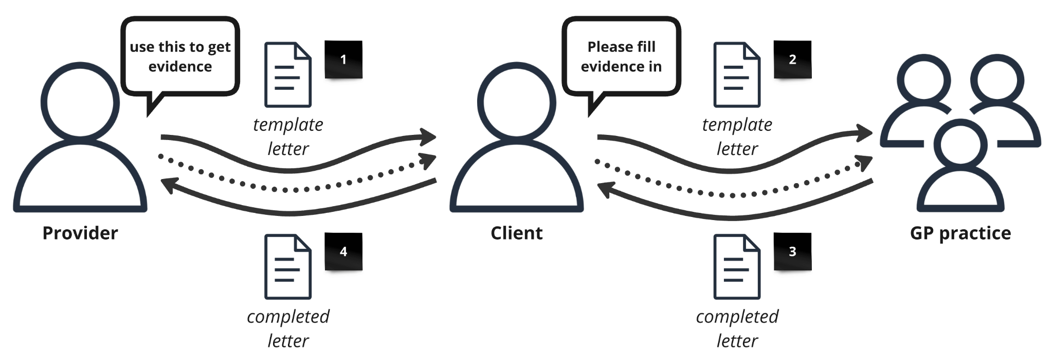
What we require people to do

Slide 24
“I think handing anything over to the client to do, knowing our clients, they struggle. They struggle just getting the bank statements, nevermind downloading a gateway letter and in some way getting it to their GP. I just can imagine that it’s probably 1 in 10 that would be able to do that, or would in fact do it, get round to doing it in a timely fashion...I could imagine that we would still end up doing this.”
Lawyer, provider of legal aid

Slide 25
Barrier: Engaging with your service will cause me more trauma

Slide 26
“I think emotionally it would be an experience I don’t want to go through.”
Applicant who had experienced domestic abuse
Prototype testing: Check if you can get legal aid

Slide 27
Practical design work
Trauma-informed design = accessible service
Focus on first contact
Communicate what is involved in using our services
We need to design for people’s interacting circumstances
People often need to access legal aid with multiple problems
Housing issues, domestic abuse, child arrangements
Intersecting barriers
No access to public funds
Language barrier

Slide 28
What can we do next?
We welcome all your questions, thoughts and comments
This is a pocket of research. Are there other pockets of research and expertise around government we can learn from, exchange or share?
How does this work fit with other trauma-informed design work?
Can we talk about how we create a space for this work in our design communities?

Slide 29

services.blog.gov.uk
Notes:
If you want to see what kinds of sessions were run during Services Week they’re published on the Services in government blog.

Slide 30

Join the conversation on social media using the hashtag #ServicesWeek

